Slide 1
Activities for Student Engagement
Source: Mandernack, J. (2020). 20 Innovative Strategies and Activities to Engage Student in Synchronous and Asynchronous Remote Learning. Go2Knowledge: Innovative Educators.

Slide 2
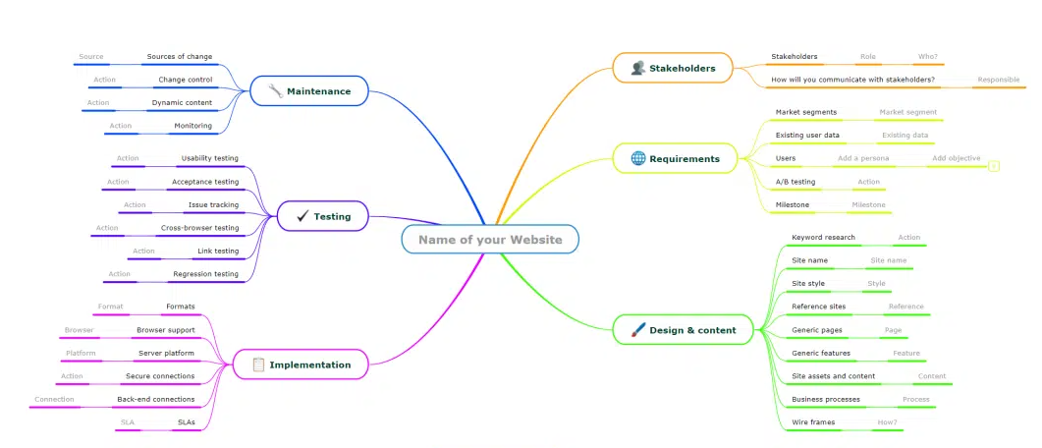
Concept Mapping
https://www.mindomo.com/mind-maps-for-education

Slide 3
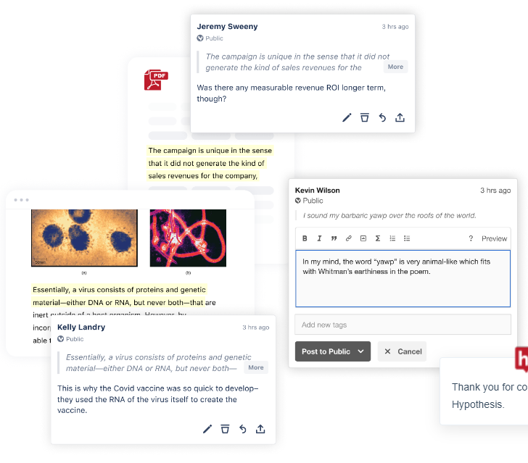
Collaborative Annotation
https://web.hypothes.is/education/

Slide 4
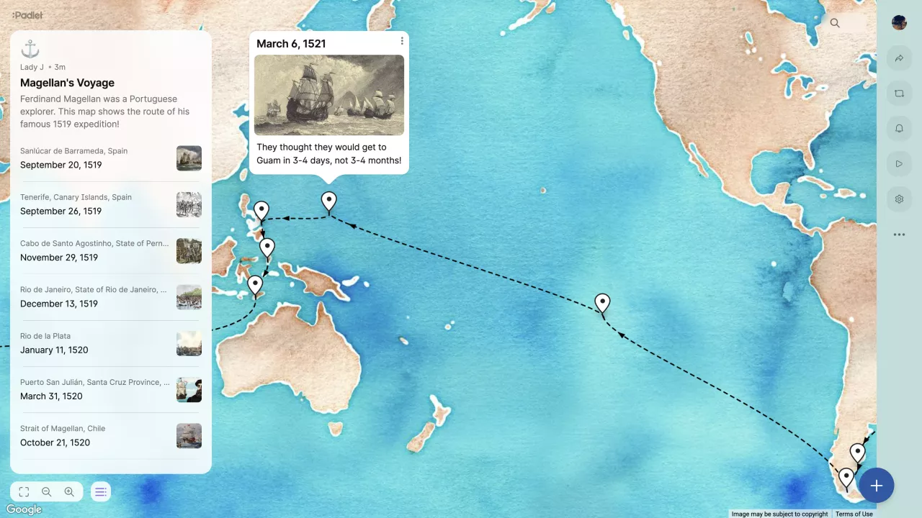
Scavenger Hunt
www.padlet.com/site/product/education
www.Loom.com/use-case/education
www.pinterest.com

Slide 5
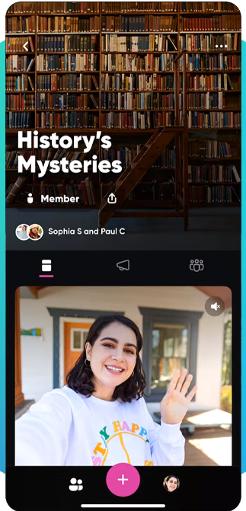
Discussions
https://info.flip.com/en-us.html
Video Discussions
Try Student-Directed Discussions
Assign Topic
Assign Student a role
Leader
Researcher
Mediator
Devil’s Advocate

Slide 6
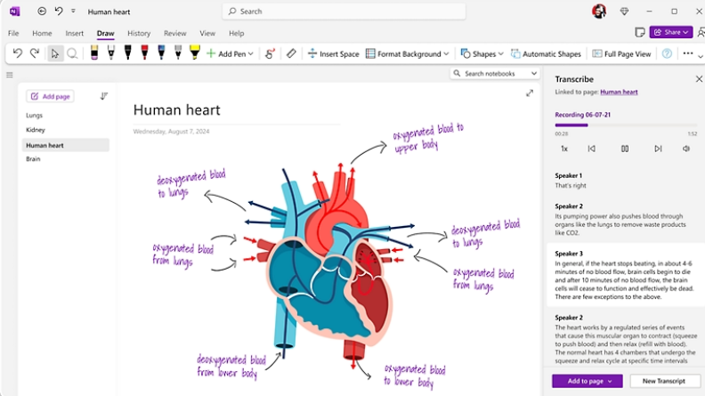
Group Notes
Outlines
Wikis
Share documents
https://docs.google.com
https://google.com/keep
www.evernote.com (student discount)
www.clickup.com
https://www.microsoft.com/en-us/microsoft-365/onenote/digital-note-taking-app

Slide 7
Other Activities
Social Media Review
Critical thinking: evaluate accuracy of information portrayed in movies and social media
Two Truths and a Lie
Students create “Two Truths and a Lie” about course concepts
Other students try to determine which statement is the lie and why
Mad Libs
Create a mad lib focusing on research, course concepts, content application
Students work in teams to complete
Share and compare
Real-World Mysteries
Find real-world case/controversy/example: share the basics of the case but omit ending
What info is needed?
Where can you get needed information?
What are possible solutions?
Share the real conclusion
Compare and contrast with students’ responses

