Slide 1
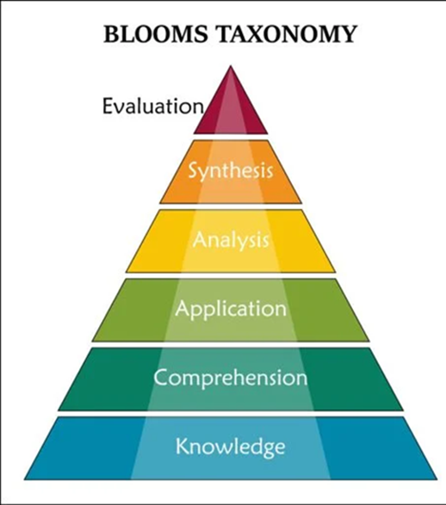
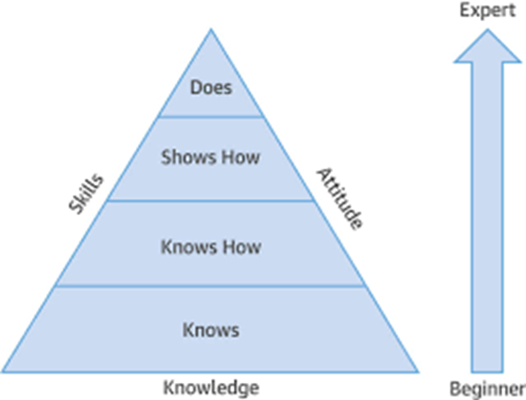
Moving from Bloom’s to Miller’s

Slide 2
Miller’s Levels
Knows: Base level – fundamental knowledge and understanding of concepts.
Knows How: Ability to apply knowledge and explain concepts.
Shows How: Demonstrates a skill or procedure in a controlled setting (e.g., simulated environment).
Does: Performs the skill consistently, and with proficiency in real-world clinical settings.

Slide 4
Masters of Health Informatics
Assessment Method
Miller's
Pyramid
Level
Notes
Knows
Knows How
Shows
Does
How
Class participation
a
a
a
Level depends on activity
Oral presentation
a
a
a
Level depends on activity
Exam (depends on question type)
a
a
Quiz (depends on question type)
a
a
Paper, report, essay
a
a
a
a
Level depends on activity
Discussion
a
a
a
Poster
a
a
Multiple choice
a
a
Short answer
a
a
a
Individual student presentations
a
a
a
Team presentations
a
a
Online discussion forums
a
a
a
Instructor observation during class
a
a
a
Pre/post knowledge testing
a
a

Slide 5
Masters of Health Informatics
Assessment Method
Miller's
Pyramid
Level
Notes
Knows
Knows How
Shows
Does
How
Project
a
a
a
Level depends on activity
Simulation
a
a
Level depends on activity
Role play
a
a
Level depends on activity
Journals, logs
a
a
Essay
a
a
a
Problem-based scenarios
a
a
Extended matching
a
Case-based multiple choice
questions
a
Observation of the student's ability to
work well in a team setting (team
project)
a
a
Pre/post skill testing
a
a

Slide 6
Masters of Health Informatics
Assessment Method
Miller's
Pyramid
Level
Notes
Knows
Knows How
Shows
Does
How
Case analysis / case-based learning
a
a
Problem solving
a
a
a
Observations of the student's ability -
internship supervisor
a
a
Peer evaluation of team participation
a
Observation checklists
a
Capstone
a
a
-Direct observation
a
-Practice portfolio
a
-Narratives
a
Peer evaluation in team projects
a
a
Final Paper
a
a
Internship
a
a
Practicum
a
a

Slide 7
Continuum of Novice to Expert
Novice learners should be able to recall facts, but as their understanding increases, they should be able to interpret and apply, demonstrate, and perform required knowledge, skills, and attitudes in authentic practice settings.
Assessments should also evolve from traditional tests to more authentic assessments

