Slide 1
Developing a Competency Based Curriculum – Undergraduate HIM to HI
Sue S. Feldman, RN, MEd, PhD, FACMI
Professor and Director of Graduate Programs in Health Informatics
University of Alabama at Birmingham
sfeldman@uab.edu

Slide 2
Introduction
Competency-based education involves ensuring “an observable ability of a health professional, integrating multiple components such as knowledge, skills, values, and attitudes. Since competencies are observable, they can be measured and assessed to ensure their acquisition. Competencies can be assembled like building blocks to facilitate progressive development.”¹
Alignment needed – Each individual lesson was now seen as a more integral part of a much larger ecosystem for each program
  Curriculum with the AMIA foundation domains required for CAHIIM Accreditation
  Learning assessments with assignments with learning outcomes
  Between course objectives and program objectives
This may be a paradigm shift for many HIM programs
¹Frank JR, Snell LS, Cate OT et al. Competency-based medical education: theory to practice. Medical teacher 2010; 32: 638-645.

Slide 3

Saif Khairat, Sue S Feldman, Arif Rana, Mohammad Faysel, Saptarshi Purkayastha, Matthew Scotch, Christina Eldredge, Foundational domains and competencies for baccalaureate health informatics education, Journal of the American Medical Informatics Association, Volume 30, Issue 10, October 2023, Pages 1599–1607, https://doi.org/10.1093/jamia/ocad147

Slide 4
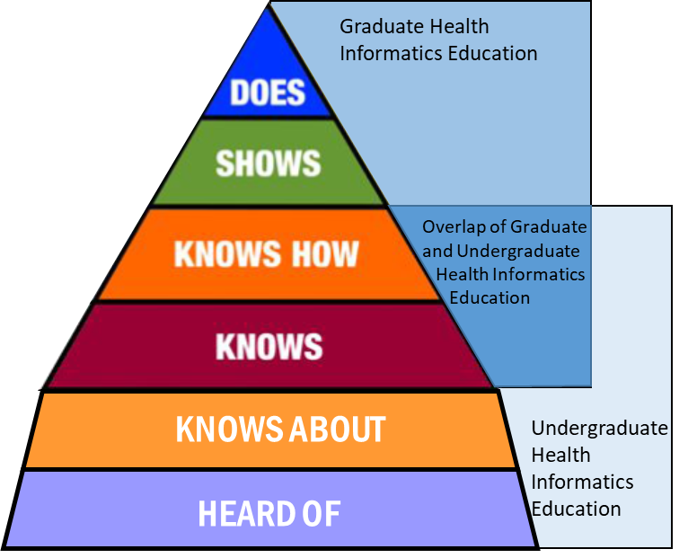
Miller’s – A Reminder²
²Saif Khairat, Sue S Feldman. Undergraduate Health Informatics Education in Berner, E. S. (2020). Informatics education in healthcare: lessons learned (pp. 289-300). Springer International Publishing.

Slide 5
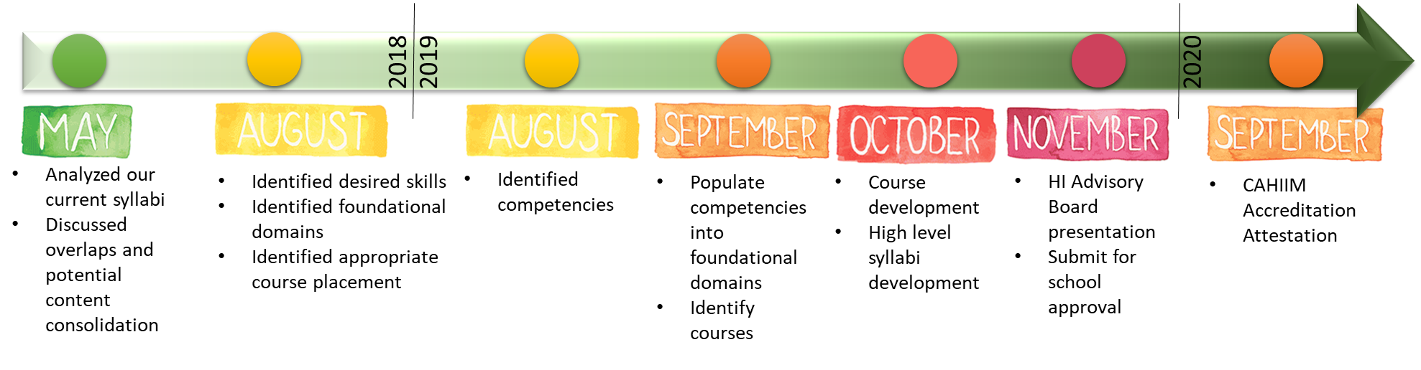
What we did
Regular meetings of 11 faculty over an 18-month period
Modified card sort methodology
NVivo for analysis
Tableau for data visualization

Slide 6
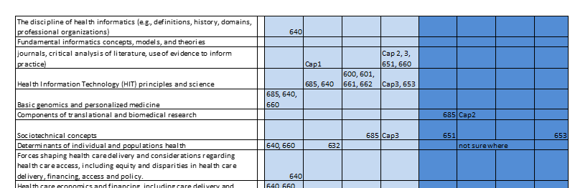
It all Started from the Delineation of Practice

Slide 7
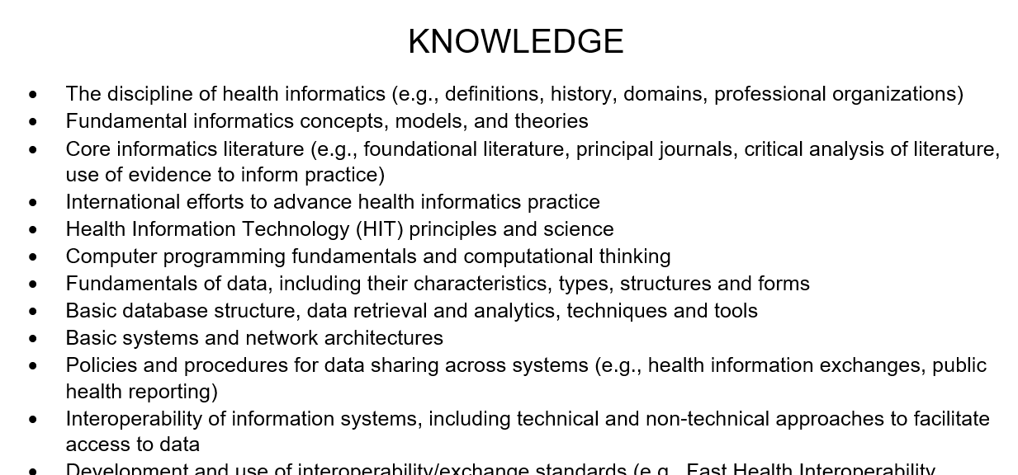
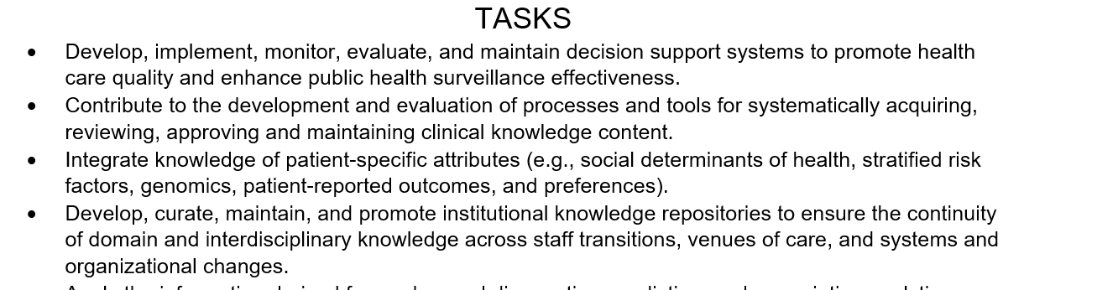

Slide 8
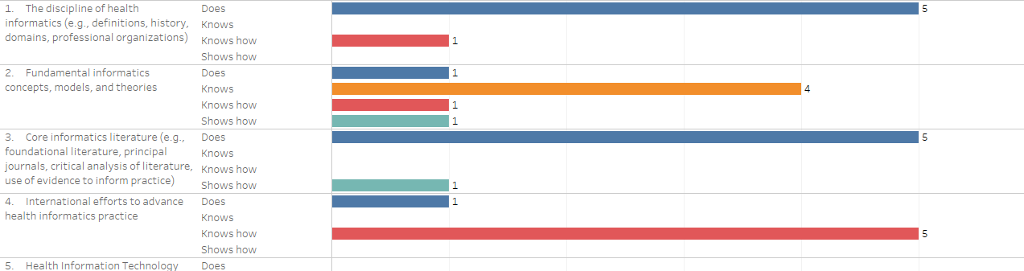
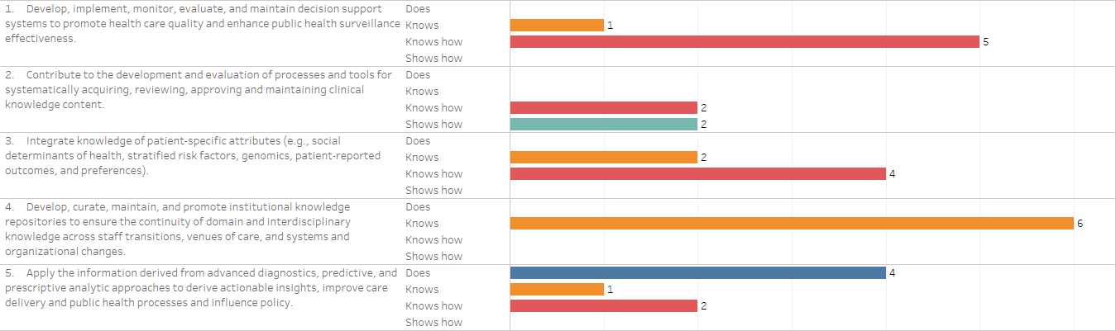
Knowledge and Tasks by Miller’s Level

Slide 9
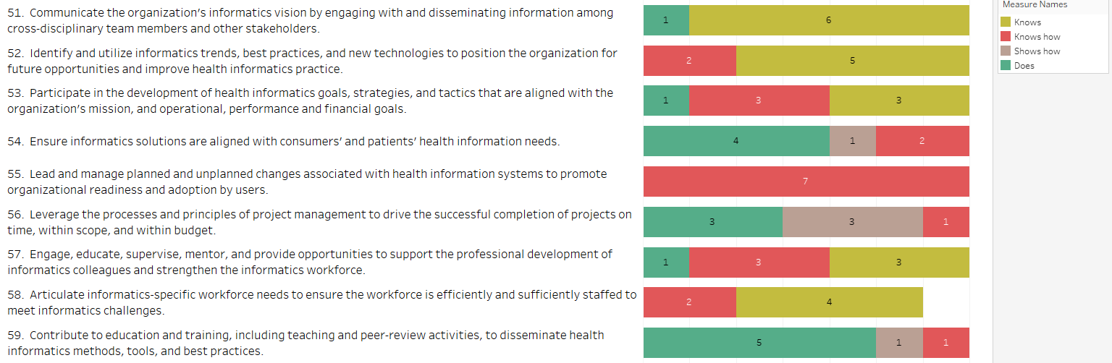
Miller’s Level by Delineation of Practice (current state)

Slide 10

Todd R Johnson, Eta S Berner, Sue S Feldman, Josette Jones, Annette L Valenta, Damian Borbolla, Gloria Deckard, LaVerne Manos, Mapping the delineation of practice to the AMIA foundational domains for applied health informatics, Journal of the American Medical Informatics Association, Volume 30, Issue 10, October 2023, Pages 1593–1598, https://doi.org/10.1093/jamia/ocad146

Slide 11
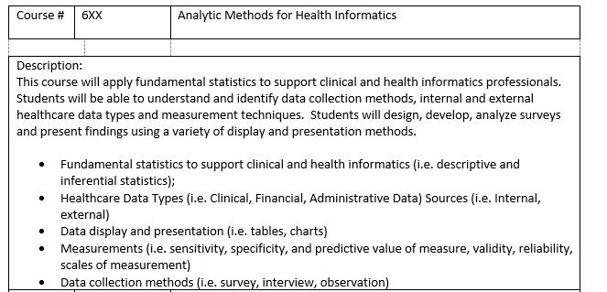
Course Template to see all Descriptions and Course Objectives Together

Slide 12
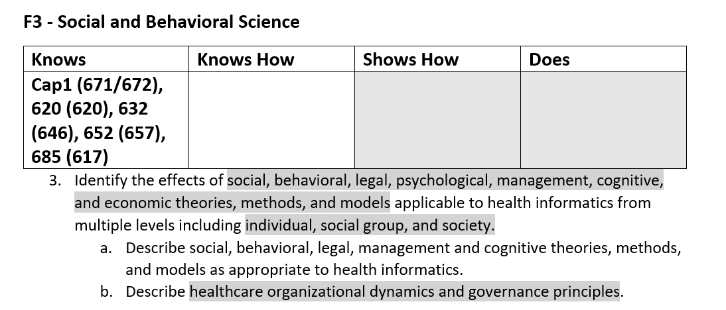
Develop new Learning Objectives – Use Keywords from Foundational Domains

Slide 13
CSET- Curriculum Self Evaluation Tool

Slide 14
Thank you!
Questions
Sue S. Feldman, RN, MEd, PhD, FACMI
Professor and Director of Graduate Programs in Health Informatics
University of Alabama at Birmingham

