Slide 1
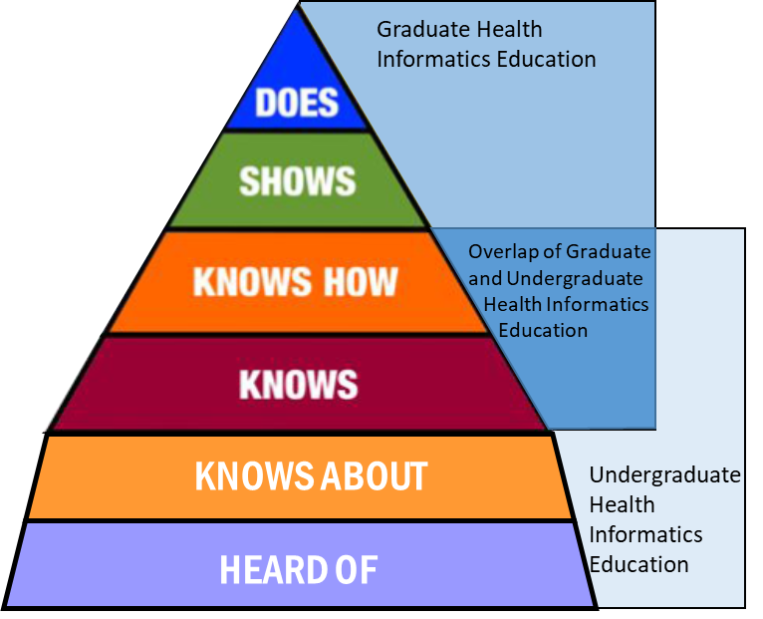
Miller’s Pyramid as Adapted for HI
Extended the MHI Miller’s Pyramid to include “knows about” and “heard of”
Khairat, S., Feldman, S.S. (2020). Undergraduate Health Informatics Education. In: Berner, E.S. (eds) Informatics Education in Healthcare. Health Informatics. Springer, Cham. https://doi.org/10.1007/978-3-030-53813-2_6

Slide 2
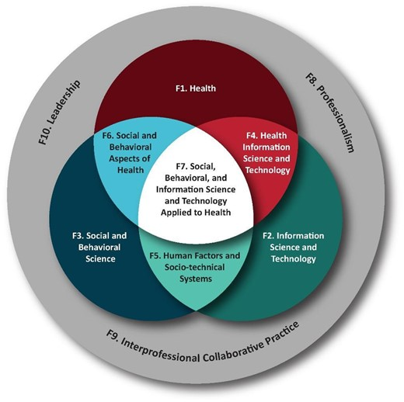
Foundational Domains
Adapted from Masters Domains
10 domains
3 major domains
Valenta, A. L., Berner, E. S., Boren, S. A., Deckard, G. J., Eldredge, C., Fridsma, D. B., Gadd, C., Gong, Y., Johnson, T., Jones, J., Manos, E. L., Phillips, K. T., Roderer, N. K., Rosendale, D., Turner, A. M., Tusch, G., Williamson, J. J., & Johnson, S. B. (2018). AMIA Board White Paper: AMIA 2017 core competencies for applied health informatics education at the master's degree level. Journal of the American Medical Informatics Association : JAMIA, 25(12), 1657–1668. https://doi.org/10.1093/jamia/ocy132
Notes:
-For the approach to creating the undergraduate level health informatics foundational domains, the BEC modified the existing graduate level domains for master’s health informatics education for harmonization between the 2 levels
-Many of you may have already seen this Venn diagram if you have worked on or used the graduate level foundational domains.
-For review, let me highlight some of the main points:
-The are 10 domains
-3 domains are foundations or the “base” of the model and interact with all of the other domains, these are professionalism,
leadership, and teamwork.
-3 domains are the basis of the knowledge for health informatics, these are F1-3 which are the major or “parent” domains.

Slide 3
Major domains
Health
Information Science & Technology
Social and Behavioral Science
Knowledge-based
Identify, describe, etc.
Crossovers create F4-7
Notes:
The 3 major knowledge-based domains are: health, information science & technology, and social and behavioral science.
I like to first look at these and note the interactions, at that point is where the last domains are created F4-7.

Slide 4
Domains F4-10 and KSAs
F2
F3
F1
Skills
Attitudes
F6
F4
F7
F5
Notes:
Going back to the original Venn diagram again, you seen the overlap with the 3 major domains and the foundational domains.
This is where the skills and attitudes competencies come in.
F7 being the “pinnacle” of the diagram where the most overlap occurs. I think of this domain as being covered by an internship or a capstone project.
Next slide

Slide 5
Domains F4-10 and KSAs
Knowledge (F1-10)
Skills (F4-10)
Attitudes (F4-10)
Notes:
Going back to the original Venn diagram again, you seen the overlap with the 3 major domains and the foundational domains.
This is where the skills and attitudes competencies come in.
F7 being the “pinnacle” of the diagram where the most overlap occurs. I think of this domain as being covered by an internship or a capstone project.
Next slide

Slide 6
Foundational Domains
F1 – Health
At the time of graduation from an applied bachelor’s program related to health informatics, the undergraduate student should be able to…
Describe the history, goals, methods (including data and information used and produced), and current challenges of the major health science fields. These include foundations in healthcare terminology, clinical workflow and processes, healthcare delivery and the healthcare environment, translational science, patient engagement, consumer health, public health, and quality improvement.
F2 – Information Science and Technology
At the time of graduation from an applied bachelor’s program related to health informatics, the undergraduate student should be able to…
Understand key concepts and methods used in information science and technology.
Identify the applicable tools for data capture, storage, retrieval, and analysis for a given informatics problem.
Work in teams to secure/protect information.
Notes:
For each domain, the descriptions and competencies were modified or adjusted to fit the undergraduate level educational level.
I’ll brief review an example from each of the domain categories.
For Health, by the time of graduation, a study should be able to describe the history, goals, methods, and challenges of the major health science fields. From there you see the examples of topics which should be included to cover this major domain. For undergraduate there is more focus on consumer health as opposed to genomics in the MS domains.

Slide 7
Foundational Domains
F3 – Social and Behavioral Science
At the time of graduation from an applied bachelor’s program related to health informatics, the undergraduate student should be able to…
K- Identify the effects of social, behavioral, and psychological models applicable to health informatics from multiple levels including individuals, organizations, social groups, and society.
F4 – Health Information Science and Technology
At the time of graduation from an applied bachelor’s program related to health informatics, the undergraduate student should be able to…
K - Identify possible biomedical and health information science and technology methods and tools for solving a specific biomedical and health information problem. Core health information technology tools may be dependent upon the application area of the training program.
S- Identify and describe a solution to a biomedical or health information problem by applying computational and systems thinking, information science, and technology.
A - Demonstrate consideration of the advantages and limitations of using information science and technology to solve biomedical and health information problems as well as the needs of the different stakeholders and context.
Notes:
For the domains created by the lap of the 3 major domains, skills and attitudes are also included in the domain.
For example, F4 is information science and technology as applied to health.
K: At the time of graduate, a BS student in HI should be able to identify possible biomedical and health information science and technology methods and tools for solving a specific health information problem.
S: the student should be able to describe a solution by applying computational and systems thinking, IS, and technology. This is that “knows” and “knows how” level of Miller’s Pyramid.
A: Demonstration consideration

Slide 8
Foundational Domains
F5 – Human Factors and Socio-technical Systems
At the time of graduation from an applied bachelor’s program related to health informatics, the undergraduate student should be able to…
Draw on socio-technical knowledge regarding the social behavioral models and human factors engineering to identify the design and implementation principles of information systems and technology.
Identify and describe social behavioral models and human factors engineering relevant to the design and evaluation of information systems and technology.
Demonstrate sensitivity to (understanding of) for the role of users in the design and application of information systems and technology.
F6 – Social and Behavioral Science Aspects of Health
At the time of graduation from an applied bachelor’s program related to health informatics, the undergraduate student should be able to…
Understand models that explain and modify patient or population behaviors related to health and health outcome.
Identify models, which may be dependent upon the application area of the training program, to address social and behavioral problems related to health of individuals, populations, and organizations
Recognize the importance of social and behavioral models related to health and their contribution to the health of individuals and populations.
Notes:
A similar method was used for F5 Human factors and socio-technical systems and F6 Social and Behavioral Science applied to the health domain.

Slide 9
Foundational Domains
F7 - Social, Behavioral, and Information Science and Technology Applied to Health
At the time of graduation from an applied bachelor’s program related to health informatics, the undergraduate student should be able to…
Identify the models from social, organizational, human factors, behavioral, and information sciences and technologies for designing, implementing, and evaluating health informatics solutions. Models may be dependent upon the application area of the educational program.
Identify and describe the models from social, organizational, human factors, behavioral, and information sciences and technologies to design, implement, and evaluate health informatics solutions. Models may be dependent upon the application area of the educational program
Recognizes the interrelatedness of social, organizational, human factors, behavioral, and information sciences and technologies in the design, implementation, and evaluation of health informatics solutions.
F8 - Professionalism
At the time of graduation from an applied bachelor’s program related to health informatics, the undergraduate student should be able to…
Define and discuss ethical principles and the informaticians' roles and responsibilities to the profession, their employers, patients, health consumers, and any other stakeholders of the informatics solutions they aid in developing, implementing, and maintaining.
Define professional practices that incorporate ethical principles and values of the discipline and demonstrate professionalism during interactions with colleagues and stakeholders in the field.
Demonstrate awareness of the value of information literacy and lifelong learning, maintenance of skills, and professional excellence.
Notes:
Here is the pinnacle F7 again as mentioned before.
Also, we start to see the foundational domains of F8-F10 here which also use the KSA methods of describing the core competencies.
You see in the professionalism attitude how the domain is adjusted for the undergraduate student.

Slide 10
Foundational Domains
F9 – Interpersonal Collaborative Practice
At the time of graduation from an applied bachelor’s program related to health informatics, the undergraduate student should be able to…
Define the scope of practice and roles-and responsibilities of different health professionals and stakeholders to perform effectively in different team roles to solve health information problems.
Apply the principles of interprofessional communication practices in a responsive and responsible manner as a participant that supports a team-based approach to solving health information problems.
Recognize the importance of mutual respect and shared values, one’s own role and those of other professions and stakeholders, and the role of teams and teamwork to solve health information problems.
F10 - Leadership
At the time of graduation from an applied bachelor’s program related to health informatics, the undergraduate student should be able to…
Articulate the concepts, tools, and characteristics of various leadership models.
Describe skills about leadership and followership concepts and tools to ensure a team progresses toward accomplishing a health informatics vision.
Demonstrate leadership behaviors as a participant in the larger goal of achieving a vision for health informatics solutions.
Notes:
In F10, you see how the attitude competency was adjusted for the undergraduate level, how the student would be a participant in the larger goal vs. demonstrating leadership behaviors themselves.

Slide 11
Questions?
Christina Eldredge
celdredge2@usf.edu

