Slide 1
Artificial Intelligence
Panel Discussion

Slide 2
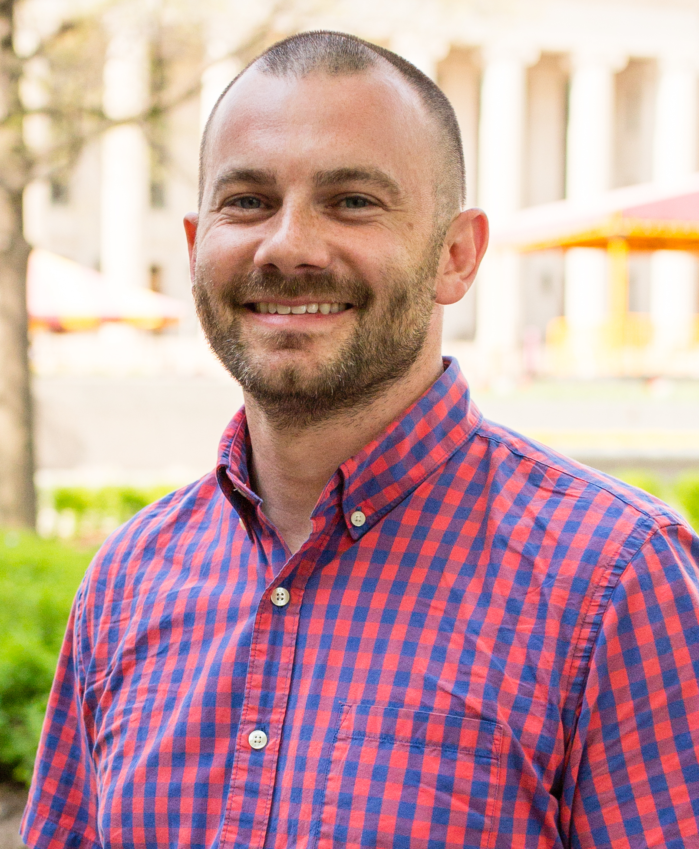
Introductions
David Marc, PhD, CHDA
The College of St. Scholastica
Akshat Kapoor, PhD
East Carolina University
Ray Hylock, PhD
East Carolina University
Norb Belz, PhD,
Seva Learning

Slide 3
Discussion Questions
Understanding AI:
What is the fundamental difference between narrow AI (task-specific) and general AI (human-like intelligence)? How does this distinction impact its applications in education and healthcare?
Healthcare Applications:
What are some general applications of AI in healthcare today?
HIM and AI:
How does AI impact the work of HI professionals?
What role should HI professionals play in making decisions about the development, deployment, use, and maintenance of AI?
Educational Opportunities:
How can impact learning and education for our HIIM students?
How can AI impact tasks for HIIM educators?
Can you share examples of successful AI-driven educational tools or platforms?
Ethical and Social Implications:
What steps can educators take to ensure transparency, accountability, and responsible use of AI applications?
How can we prepare students and healthcare professionals for a future where AI is integral to their work?
Collaboration and Training:
How can educators collaborate with AI systems effectively? What skills are essential for this collaboration?
What ongoing training and professional development are necessary for educators and HIM professionals to stay informed about AI advancements?

