Slide 1
Authentic/Experiential Learning
Internships, PPE, Classroom Active Learning

Slide 2
Standard 23 – Experiential Learning and Assessment
Program must integrate authentic experiential learning opportunities beginning within the first year of the program to allow the students to practice and demonstrate the competencies
First year authentic experiential learning experiences can be supervised and assessed by the program or external professionals
Prior to the completion of the program, the student must particiate in experiential learning outside the classroom supervise by an external professional

Slide 3
Authentic and Experiential Learning
In education, the term authentic learning refers to a wide variety of educational and instructional techniques focused on connecting what students are taught in school to real-world issues, problems, and applications.
Authentic Learning describes learning activities that are either carried out in real-world context or have high transfer to a real-world setting.
Authentic learning tasks teach students how to think like a member of their discipline
Notes:
authentic learning activities can be useful in bridging the gap between what students typically do in the classroom and what they will be expected to be able to do in their field, once they leave the university setting.
Experiential Learning is the process of learning by doing. By engaging students in hands-on experiences and reflection, they are better able to connect theories and knowledge learned in the classroom to real-world situations

Slide 4
Authentic and Experiential Learning
Fieldwork and work-study placements for course credit are considered the most extreme examples of authentic learning experiences, as students are literally learning on-the-job rather than attending a class
Notes:
What about Study Abroad – does anyone offer study abroad courses for their HIM majors? Tell us about it please.

Slide 5
Authentic and Experiential Learning
Authentic learning can also take place within the walls of the classroom itself
Teaching methods include case-based instruction, where instructors use real or fictional cases as vehicles to present content or to require students to apply skills
Inquiry projects, where students work on a “real-life” problem of practice, and often have some choice of topic, give students the opportunity to see how problems are investigated or solved in the real world
Project-based assessment (as opposed to exams) is also a hallmark of authentic learning
The common element to these methods is that they activate students’ motivation and curiosity by presenting them with real-world problems that feel interesting and important.
Notes:
Field trips
Art projects
Science experiments
Role-playing exercises
Reflection and journaling
Opportunities for internship
Interactive classroom games

Slide 6
Five Standards for Authentic Learning
Higher-level thinking
Depth of Knowledge
Connectedness to the world beyond the classroom
Substantive conversations
Social support for student achievement

Slide 7
Sharing/Reflecting “What Happened?”
Students will share the results, reactions and observations with their peers
Students will also get other peers to talk about their own experience, share their reactions and observations and discuss feelings generated by the experience
The sharing equates to reflecting on what they discovered and relating it to past experiences which can be used for future use

Slide 8
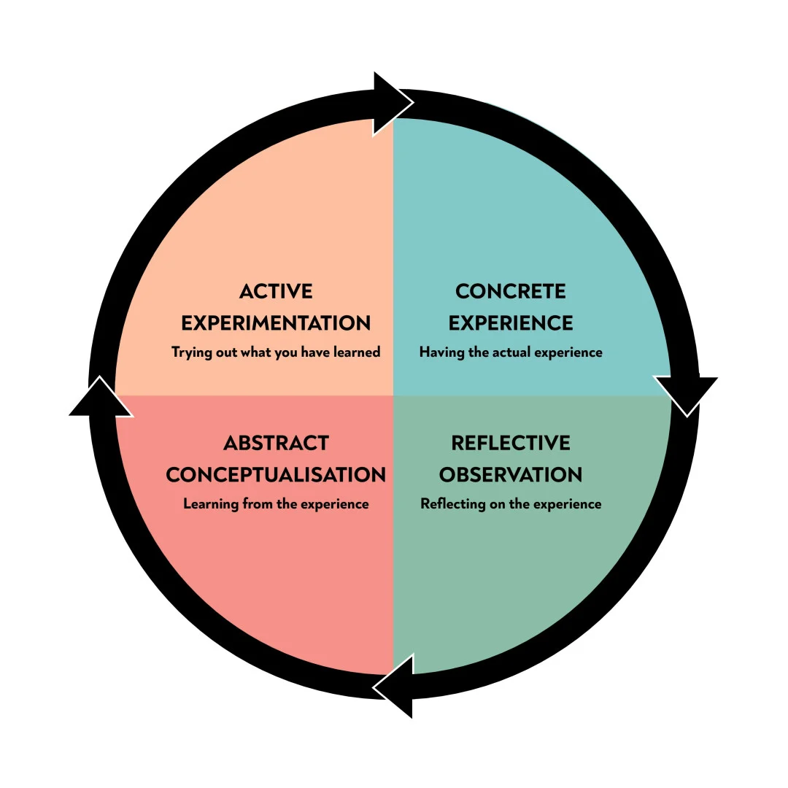
Kolb’s Experiential Learning Cycle
Notes:
David Kolb’s Theory of Experiential Learning. Kolb proposed that experience was critical in the development of knowledge construction, as learning occurs through discovery and active participation. Kolb defined leaning as “the process whereby knowledge is created through the transformation of experience” (Kolb, 1984).
The first is that learning follows a four-stage cycle, as outlined below. Kolb believed that, ideally, learners progressed through the stages to complete a cycle, and, as a result, transformed their experiences into knowledge.
Experiencing – Reflecting – Thinking – Acting.
Experiencing (Concrete Experience): Learning begins when a learner uses senses and perceptions to engage in what is happening now.
Reflecting (Reflective Observation): After the experience, a learner reflects on what happened and connects feelings with ideas about the experience.
Thinking (Abstract Conceptualization): The learner engages in thinking to reach conclusions and form theories, concepts, or general principles that can be tested
Acting (Active Experimentation): The learner tests the theory and applies what was learned to get feedback and create the next experience.
1. Concrete Experience (CE)
The Experiential Learning Cycle is typically presented with concrete experience at the top, to signify that that’s where the process begins. At this stage, learners encounter an experience. This could be either a completely new experience or a reimagined experience that has already happened.
Kolb believed that the key to learning lies in involvement. According to him, it’s not enough for learners to just read or watch demonstrations to acquire new knowledge. As such, each learner should actively engage in an experience. This could involve being exposed to a new task or a new way of carrying out a project they are already familiar with.
While the experience is usually a personal one, it might also be a shared experience. In this situation, learners acquire knowledge by observing, hearing about or reading about someone else’s experiences. And this kind of social learning comes loaded with benefits.
2. Reflective Observation (RO)
Concrete experiences are followed by reflective observation. As such, after engaging in an experience, learners should step back to reflect on the task or activity. This stage in the learning cycle allows the learner to ask questions and discuss the experience with others.
For most individuals, this is where seeing and doing transforms into the real-time absorption of new information. In practice, this could mean a situation where a person is shown how to accomplish a goal. They then look at how it could be applied in different circumstances.
Communication is vital as it allows learners to identify any discrepancies between their understanding and the experience itself. Discussing the experience with others helps to ease the reflection process by introducing other points of view.
At this stage, learners will also try to place the experience alongside other previous experiences to look for patterns or notable differences. This helps them to reflect on the discrepancy and gap between their understanding and the experience itself.
3. Abstract Conceptualisation (AC)
Reflective observation leads to abstract conceptualisation. In this stage, learners form new ideas or alter their current understanding based on the reflections that arose from the previous stage.
Learners move from reflective observation to abstract conceptualisation when they begin to classify concepts and form conclusions on the events that occurred. As such, abstract conceptualisation gives learners the chance to assess how their new ideas can be applied in the real world.
They can do so by interpreting the experience and making comparisons to their current understanding of the concept. When learners return to a task, they can then return with the goal of applying their conclusions to new experiences.
In other words, they generate abstract principles that they can apply to future situations. After all, the focus lies in drawing conclusions and learning lessons based on the experience.
This shows us that information is a lot easier to retain, if it is relevant to our lives and we are given an opportunity to apply it.
4. Active Experimentation (AE)
The last stage of the cycle involves active experimentation. At this stage, learners apply their new ideas to the world around them. This allows them to see if there are any changes in the next occurrence of the experience.
As such, this stage offers an opportunity for learners to test out their new ideas and lessons gathered from the experience. By actively experimenting with different concepts, individuals can learn how to associate what they have experienced with new ideas and innovations.
This experimentation results in new concrete experiences that effectively trigger the beginning of the next cycle. After all, life effectively amounts to a series of interlinked experiences.

Slide 9
Let’s Get Practical – Here’s what We Do
HIM 200: (sophomore year)
Monitoring federal legislation – students will research issues of the Federal Register and select a health information proposed regulation or healthcare proposed regulation. They will summarize the information and develop comments regarding the legislation
HIM 323: HIM I Lab (junior year)
Healthcare facility project – external professional
Legal assignments:
Legal Terminology I (5.16)
Legal Document Conundrum (5.19)
Legal Health Record Maintenance (5.20)
Legal Terminology II (5.21)
Legal Terminology III (5.24)
Alteration of Patient Record
Notes:
NOTE: Start recording how much time you spend on each experiential learning activity. You may be asked to document this later.
Nursing Homes – Team # 1
Physicians’ Office/Clinic – Team # 2
Home Health Agency - Team # 3
Hospice - Team # 4
Surgery Centers/Same Day Surgery Centers - Team # 5
Psychiatric Health Facility - Team # 6
Substance Abuse Facility - Team # 7
Outpatient Mental Health Clinic- Team # 8
Rehabilitation Facility - Team # 9
Urgent Care facility - Team # 10
Dentist’s Office/Clinic - Team # 11
Select a specific healthcare facility to contact according to your assigned type of healthcare facility.
Obtain the following types of information about the facility that you visit (or complete a telephone or email interview)
Complete name of organization
Organization’s Logo (if available)
Healthcare Facility Building picture (if attainable)
Address (street address, city, and zip code)
Phone number
Name of person you interviewed, individual’s credentials, and individuals position at that facility
Are EHRs utilized? If so, how long have they been using EHRs? If not, do they have future plans for an EHR. What is the name of the EHR that they use?
If EHRs are not utilized, are they 100% paper based records? Or hybrid (part paper, part electronic)
State Regulations and Accreditation Requirements that are applicable to this facility. When was the last accreditation survey/site visit?
Health care professionals (or consultants) employed in the facility (ex: RHIA, PT, OT, RN, etc.)
How does this facility differ from an acute care facility?
Any other miscellaneous information that might be interesting
Create a Power Point Presentation with your findings. You will give a two to three minute presentation to the class on your team’s specific healthcare facility. The team’s grade will be determined by this presentation and the coverage of the required material. Upload your Power Point Presentation as a PDF file to Moodle using the submission link located under Assignment # 1. Be sure to include your names on first slide of the presentation.

Slide 10
Let’s Get Practical – Here’s what We Do
HIM 323 (cont):
Information Governance Advocacy (1.19)
Information Governance Plan (1.34)
Meditech Expanse from Virtual lab – all assignments for inpatient and ambulatory
Patient Cases from Virtual lab
Numerous other case studies from AHIMA case study book

Slide 11
Let’s Get Practical – Here’s what We Do
HIM 324/326: Coding and Coding Lab (junior year)
Use the Virtual Lab Encoder for homework assignment
HIM 460: Medical Science (junior year)
Reviews charts from VLAB in relation to disease processes; nursing faculty come in and discuss the disease process with the students
HIM 431: Quality Assurance (junior year)
Query an online database of patient satisfaction ratings, analyze the data, develop improvement opportunities, and create a report for hospital administration
Notes:
The students in 460 Medical Science review charts from Vlab in relation to disease processes that we are discussing at the time. We go through the MAR, imaging, and other reports in the chart.
Coding students use the encoder to code diagnostic statements in each homework assignment.

Slide 12
Let’s Get Practical – Here’s what We Do
HIM 402: Healthcare Reimbursement Lab (senior year)
Using Virtual Lab
3M Coding and Reimbursement
CRS References
Clinical Coding and Reimbursement
MS-DRG Assignment and Evaluation
Nuance Clintegrity
Encoder tutorial
ICD-10 lab activity
Physician query
Authentic patient cases

Slide 13
Let’s Get Practical – Here’s what We Do
HIM 413: Management and Leadership Lab (senior level)
Coding productivity case study
DNFB productivity case study
Transcription performance improvement case study
Discharge planning process case study
Lecture on cover letter, resume, and Linkin – external professional
Management project: Four parts: Team Building and Leadership Soft Skills, Managing and Leading Change, Work Design and Process Improvement, Project Management

Slide 14
Let’s Get Practical – Here’s what We Do
HIM 453: PPE I (1st semester, senior year)
Twenty days in a clinical setting – hospitals, clinics, doctor’s offices (external supervision)
Weekly thoughts – reflecting and sharing with others
Daily Journal – reflecting on each day’s activities
Power Point Presentations – reflecting
Case Studies: from AHIMA case study book (2.23 and 6.33)
Assignments: Physician Assistant Documentation, Coding Audit
Project – under the direction of an external professional

Slide 15
Let’s Get Practical – Here’s what We Do
HIM 454 PPE II (2nd semester, senior year)
Six – ten days in a clinical setting – hospitals, clinics, doctor’s offices (external supervision)
Weekly thoughts – reflecting and sharing with others
Daily Journal – reflecting on each day’s activities
Power Point Presentations – reflecting
Case Studies: from AHIMA case study book (Missing Laptop, Anemia query)
Coding Audit

Slide 16
Let’s Get Practical – Here’s what We Do
HIM 482 – Management Internship (2nd semester, senior year)
Two weeks in a hospital outside of the Acadiana area (external supervision)
One week in an “alternative” setting – tumor registry, public health, medical device company, psychiatric facility, compliance, doctor’s office, educational setting, university clinic, etc. (external supervision)
Two days of in person or virtual presentations by alumni discussing their current position and their pathway to that position
Three days at the state LHIMA convention

Slide 17
Let’s Get Practical – Here’s what We Do
LCHI 490: Informatics Capstone (senior year)
Mock Interview – external professional
A Day in the Life of an HIM Director – case study
LCHI Research Poster Submission – presented to external organization
For this assignment you will develop and design a research poster based on the research topic you have chosen. I have provided you with a sample research poster template for you to utilize.
Your poster must include the following:
- Title - Introduction - Methods you used for your research - Results - Conclusions - Graphs/Images/Tables/Any additional important information - References and Acknowledgements

Slide 18
Let’s Get Practical – Here’s what We Do
LCHI Courses
Excel Review: IPPS Data presentation
Data Clean-up
SQL Assignment
Calculating Descriptive Statistics
Bad Graphs
Tableau – several projects increasingly difficult

Slide 19
Let’s Hear from You
What are Your Concerns?
Project ideas?
Games?
Management Internship Sites
External Supervision

