Slide 2
Our Mission
ECU HIM to be a student’s
first thought rather than
their second
High Schools, Early Colleges,
community colleges, hospitals, clinics,
and businesses are aware of
HIM and the flexibility of program completion
Increase ECU HIM enrollment
Business
Social Work
Nursing
HIM

Slide 3
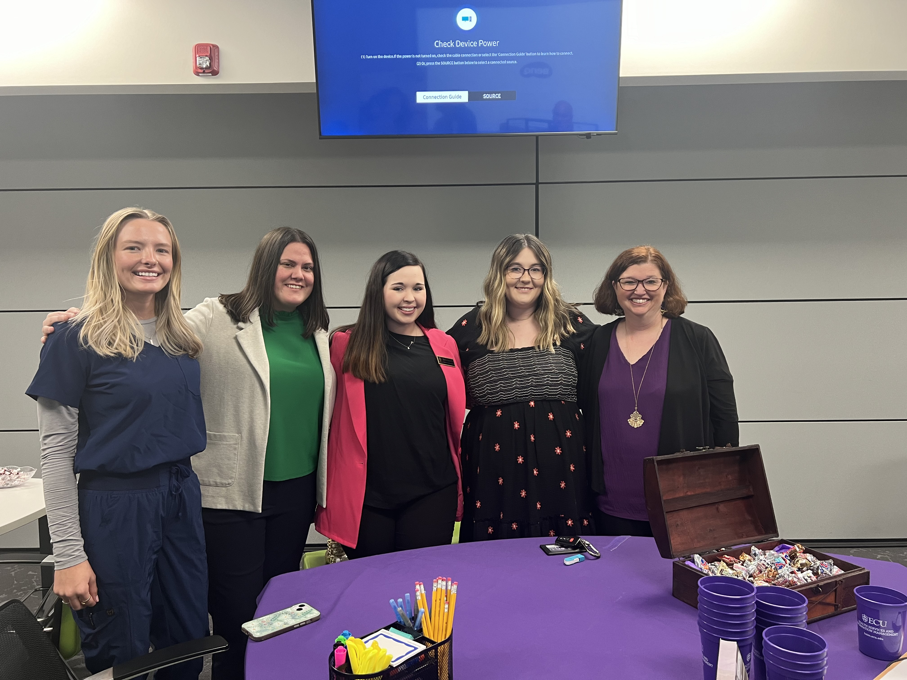
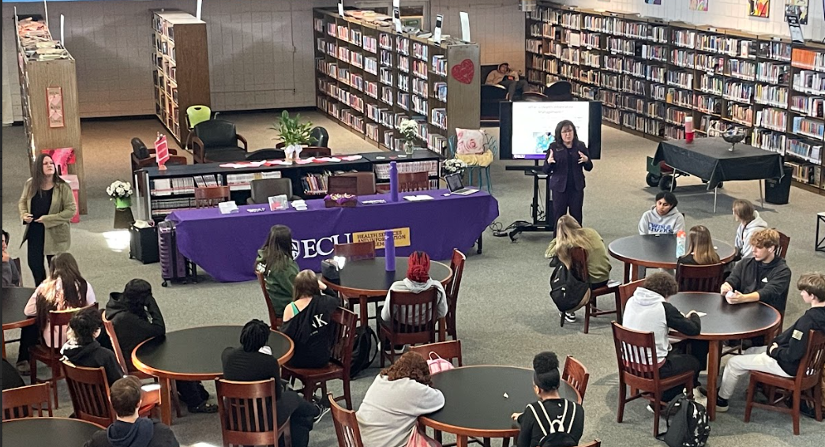
Recruitment
What we’ve done:
What we’re doing:
Havelock High School, Havelock NC, Craven County Schools
February 26th: Pitt County Schools Health Sciences Academy Career Night, Greenville, NC
Finalizing dates to visit:
Lenoir County Public Schools
Carteret Community College
Coastal Carolina Community College

Slide 4
Suggestions
How can we recruit more students?
Where should we recruit next?
What promotional items or ideas should we incorporate in our recruitment?
Who is willing to submit a testimonial on their academic and professional success?

Slide 5
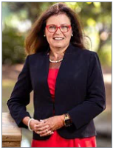
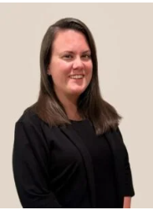
Contact Us!
Dr. Susie Harris Lauren Allen-Joyner
harrissus@ecu.edu allenjoynerl21@ecu.edu

