Slide 1
RECRUITMENT & ENROLLMENT
2024 HIIM Educators Consortium

Slide 2
ECU
ADMISSIONS

Slide 3


Slide 4
01
Context

Slide 5


Dreaming
Of
College
Being
In
College

Slide 6

Enrollment is Everyone’s Responsibility

Slide 7
02
The Problem

Slide 8
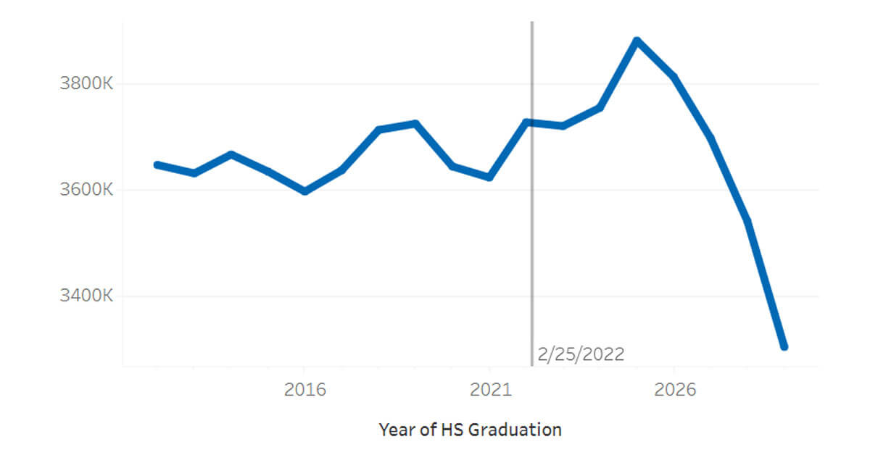
Enrollment Cliff

Slide 9

Student Retention

Slide 10
03
Good News

Slide 11
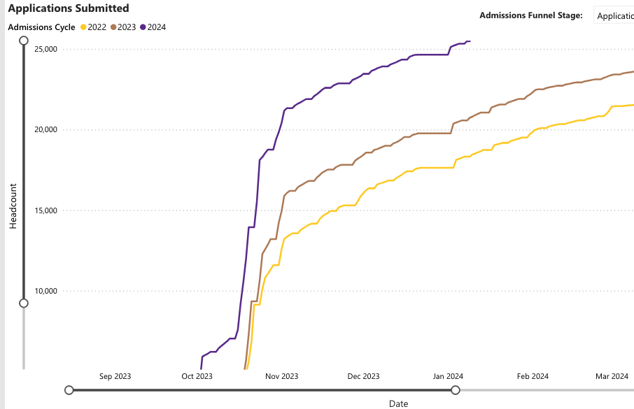
Current Application Numbers

Slide 12
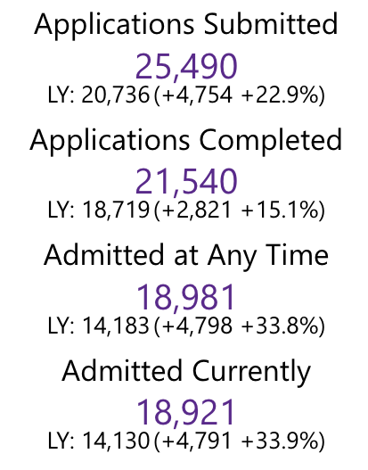
Current Application Numbers

Slide 13
04
The Future

Slide 14
Initiatives
Project Kitty Hawk
Additional ECU Online Staff
Work with Veterans- Office @ Cherry Point
Focus on Non-Traditional Students
Finish Program
ECU-Specific Free Application Week
Transfer Roadshows
New Communications Counselor
Carnegie Marketing Review

Slide 15
—Dr. Henry Cloud
“Growth is actually contagious, so if you want to reach your goals, you’ve got to get around people that are going in the same direction you want to be going, and you will catch the success.”

